Slide 1
Callbacks and Customization
韩红雷

Slide 2
概述
callback functions the SDK provides that let the user listen to simulation events
even customize some parts of the simulation
The callback functions are implemented as member functions of classes which the user is expected to subclass, providing custom implementations for the functions
same mechanism with user provide custom allocators and error notification.

Slide 3
Simulation Events
The simplest type of simulation callbacks
There is only one restriction on the code you may put in the callbacks: Any SDK state change from them is disallowed
the simulation is running in the background, as any new state is written to an inactive state backbuffer
However, these event callbacks are not called from within the simulation thread, but rather from inside fetchResults(). At that point some buffered operations have already been processed, so the situation is more fragile. All write operations to the scene should be buffered and carried out after fetchResults() returns.

Slide 4
一些events
Inside fetchResults() among other things we 'swap the buffers'. This means that we copy the objects' simulation results to their API-visible state. Some event callbacks happen before this swap, and some after.
The events that happen before are:
onTrigger
onContact
onConstraintBreak
When these events get received, the shapes, actors, etc. will still be in the state they were in before the simulation ran. This is preferable, because these events were detected early on during the simulation, before objects were integrated (moved) forward. For example, a pair of shapes that get an onContact() to report that they are in contact will still be in contact when the call is made, even though after fetchResults() returns, they may have bounced apart again.
On the other hand, these events are sent after the swap:
onSleep
onWake
Sleep information is updated after objects have been integrated, so it makes sense to send these events after the swap.

Slide 5
How to listen
First, define a callback function by subclassing PxSimulationEventCallback
Not all of its member functions have to be implemented, only the ones to be overwritten
For constraint break events, this is the only thing that needs to be done. For sleep and wake events, you must raise the flag PxActorFlag::eSEND_SLEEP_NOTIFIES on all actors from which notifies are desired
To get onContact and onTrigger events, in the filter shader callback, set a flag for all pairs of interacting objects for which you wish to receive these events

Slide 6
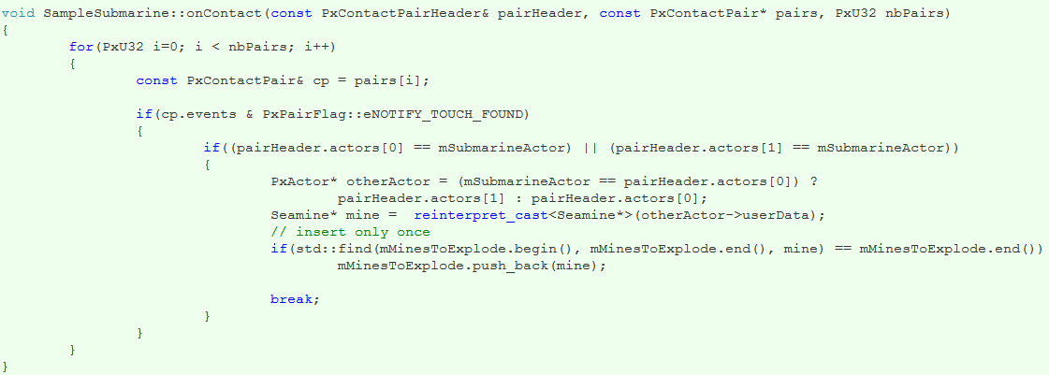
example
onContact receives the pair for which the requested contact events have been triggered
The above function is only interested in eNOTIFY_TOUCH_FOUND events, which are raised whenever two shapes start to touch
After that, it adds the mine to a set of mines that should explode during the next update.

Slide 7
Collision Filtering
need arises to exempt certain pairs of objects from interacting
or to configure the SDK collision detection behavior in a particular way for an interacting pair.

Slide 8
shader system
lets the developer implement an arbitrary system of rules using code that runs on the vector processor (and is therefore not able to access any eventual game data base in main memory
The best part is that an application can decide on a per-pair basis to make this speed vs. flexibility tradeoff.

Slide 9
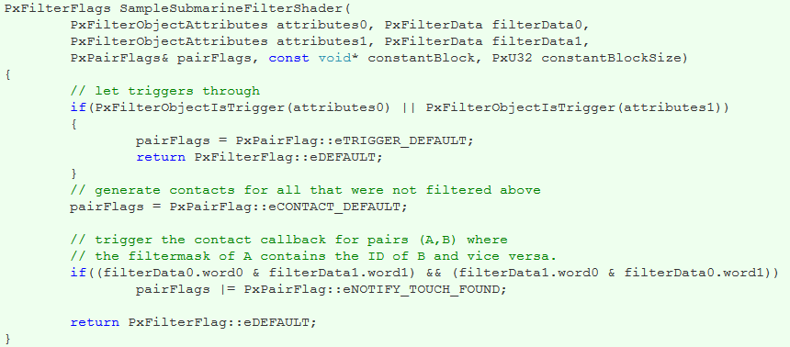

Slide 10
SampleSubmarineFilterShader is a simple shader function that is an implementation of the PxSimulationFilterShader prototype declared in PxFiltering.h
SampleSubmarineFilterShader() will be called for all pairs of shapes whose axis aligned bounding boxes in world space are found to intersect for the first time.
All behavior beyond that is determined by what SampleSubmarineFilterShader() returns.
Each PxShape and PxParticleBase object in PhysX has a member variable of type PxFilterData. This is 128 bits of user defined data that can be used to store application specific information related to collision filtering. This is the other variable that is passed to SampleSubmarineFilterShader() for each object.
Finally, SampleSubmarineFilterShader() also has a PxPairFlags parameter. This is an output, like the return value PxFilterFlags

Slide 11
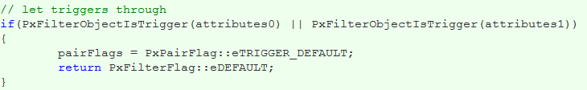
This means that if either object is a trigger, then perform default trigger behavior (notify the application about start and end of touch), and otherwise perform 'default' collision detection between them.

Slide 12
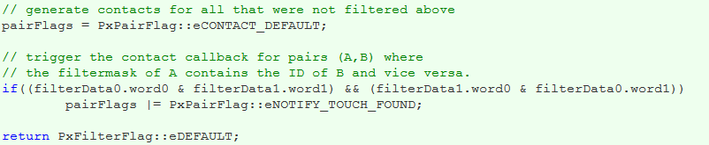
This says that for all other objects, perform 'default' collision handling. In addition, there is a rule based on the filterDatas that determines particular pairs where we ask for touch notifications. To understand what this means, we need to know the special meaning that the sample gives to the filterDatas.

Slide 13
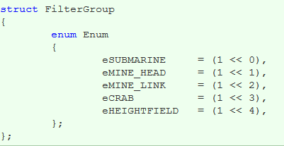
The needs of the sample are very basic, so we will use a very simple scheme to take care of it. The sample first gives named codes to the different object types using a custom enumeration:

Slide 14
The sample identifies each shape's type by assigning its PxFilterData::word0 to this FilterGroup type
Then, it puts a bit mask that specifies each type of object that should generate a report when touched by an object of type word0 into word1.
This could be done in the samples whenever a shape is created, but because shape creation is a bit encapsulated in SampleBase, it is done after the fact, using this function:

Slide 15
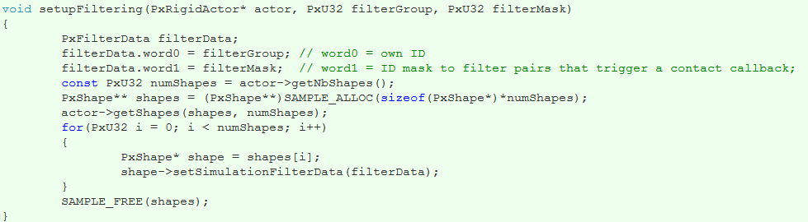
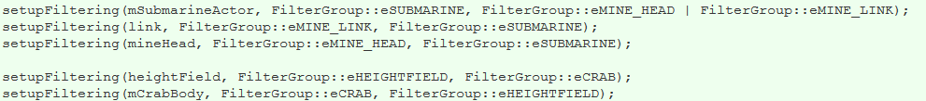
This sets up the PxFilterDatas of each shape belonging to the passed actor
Here are some examples how this is used in SampleSubmarine:

Slide 16
This scheme is probably too simplistic to use in a real game, but it shows the basic usage of the filter shader, and it will ensure that SampleSubmarine::onContact() is called for all interesting pairs.
An alternative group based filtering mechanism is provided with source in the extensions function PxDefaultSimulationFilterShader. And, again, if this shader based system is too inflexible, consider using the callback approach provided with PxSimulationFilterCallback.

Slide 17
Contact Modification
Sometimes users would like to have special contact behavior.
For example to implement sticky contacts, give objects the appearance of floating or swimming inside each other, or making objects go through apparent holes in walls.
A simple approach to achieve such effects is to let the user change the properties of contacts after they have been generated by collision detection, but before the contact solver
Because both of these steps occur within the scene simulate() function, a callback must be used.
The callback occurs for all pairs of colliding shapes for which the user has specified the pair flag PxPairFlag::eMODIFY_CONTACTS in the filter shader.

Slide 18

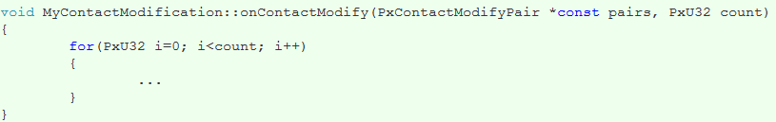
To listen to these modify callbacks, derive from the class PxContactModifyCallback:
And then implement the function onContactModify of PxContactModifyCallback:

Slide 19
Basically, every pair of shapes comes with an array of contact points, that have a number of properties that can be modified, such as position, contact normal, and separation. For the time being, friction properties of the contacts cannot be modified
the callback should be thread safe and reentrant. In other words, the SDK may call onContactModify() from any thread and it may be called concurrently (i.e., asked to process sets of contact modification pairs simultaneously).
The contact modification callback can be set using the contactModifyCallback member of PxSceneDesc or the setContactModifyCallback() method of PxScene.

Slide 20
Active Transforms
The active transforms API provides an efficient way to reflect actor transform changes in a PhysX scene to an associated external object such as a render mesh.
When a scene's fetchResults() method is called an array of PxActiveTransform structs is generated, each entry in the array contains a pointer to the actor that moved, its user data and its new transform. Because only actors that have moved will be included in the list this approach is potentially much more efficient than, for example, analyzing each actor in the scene individually.

Slide 21
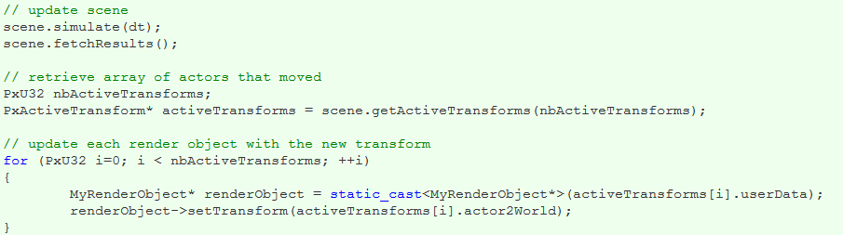
The example below shows how to use active transforms to update a render object:

